Slide 1

Security Strategy Frames
Models and Frameworks to democratize Security Strategy development
@madplatt

Slide 2

Democratizing Strategy ?
@catswetel
@madplatt

Slide 3
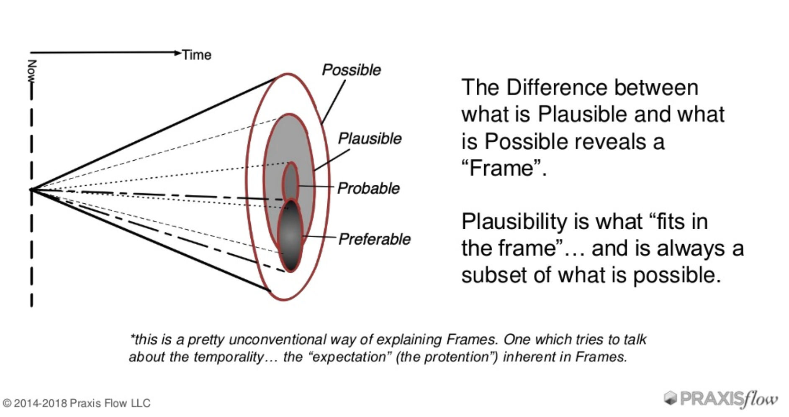
What are frames ?
@cyetain – Jabe Bloom
@madplatt

Slide 4
Layered approach
Strategy and Sense-making
Good/Bad Strategy
Wardley Mapping
Security
Structure
Enterprise Security Architecture
Cyber Defence Matrix
D.I.E
Open Source and Cloud Native
Cynefin
Compliance Maze
@madplatt

Slide 5
Navigating Strategy
@madplatt

Slide 6
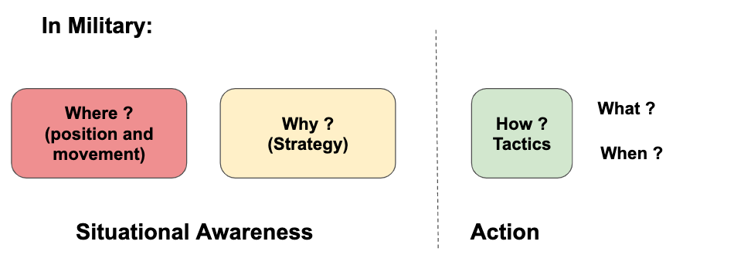
A good strategy is straightforward, simple and easy to understand. It constitutes of “strength applied to the most promising opportunity.” Richard Rumelt
To strategize means to identify essential issues that trouble your industry or organisation, and to consequently make a plan and take result-oriented action towards fixing those critical points.
@madplatt

Slide 7
Good Strategy or Bad Strategy ?
Good strategy
Bad strategy
Fluff / Memes
Failure to face the challenge
Mistaking goals for strategy
Bad strategic objectives
Diagnosis
Guiding Policy
Set of Coherent Actions
@madplatt

Slide 8
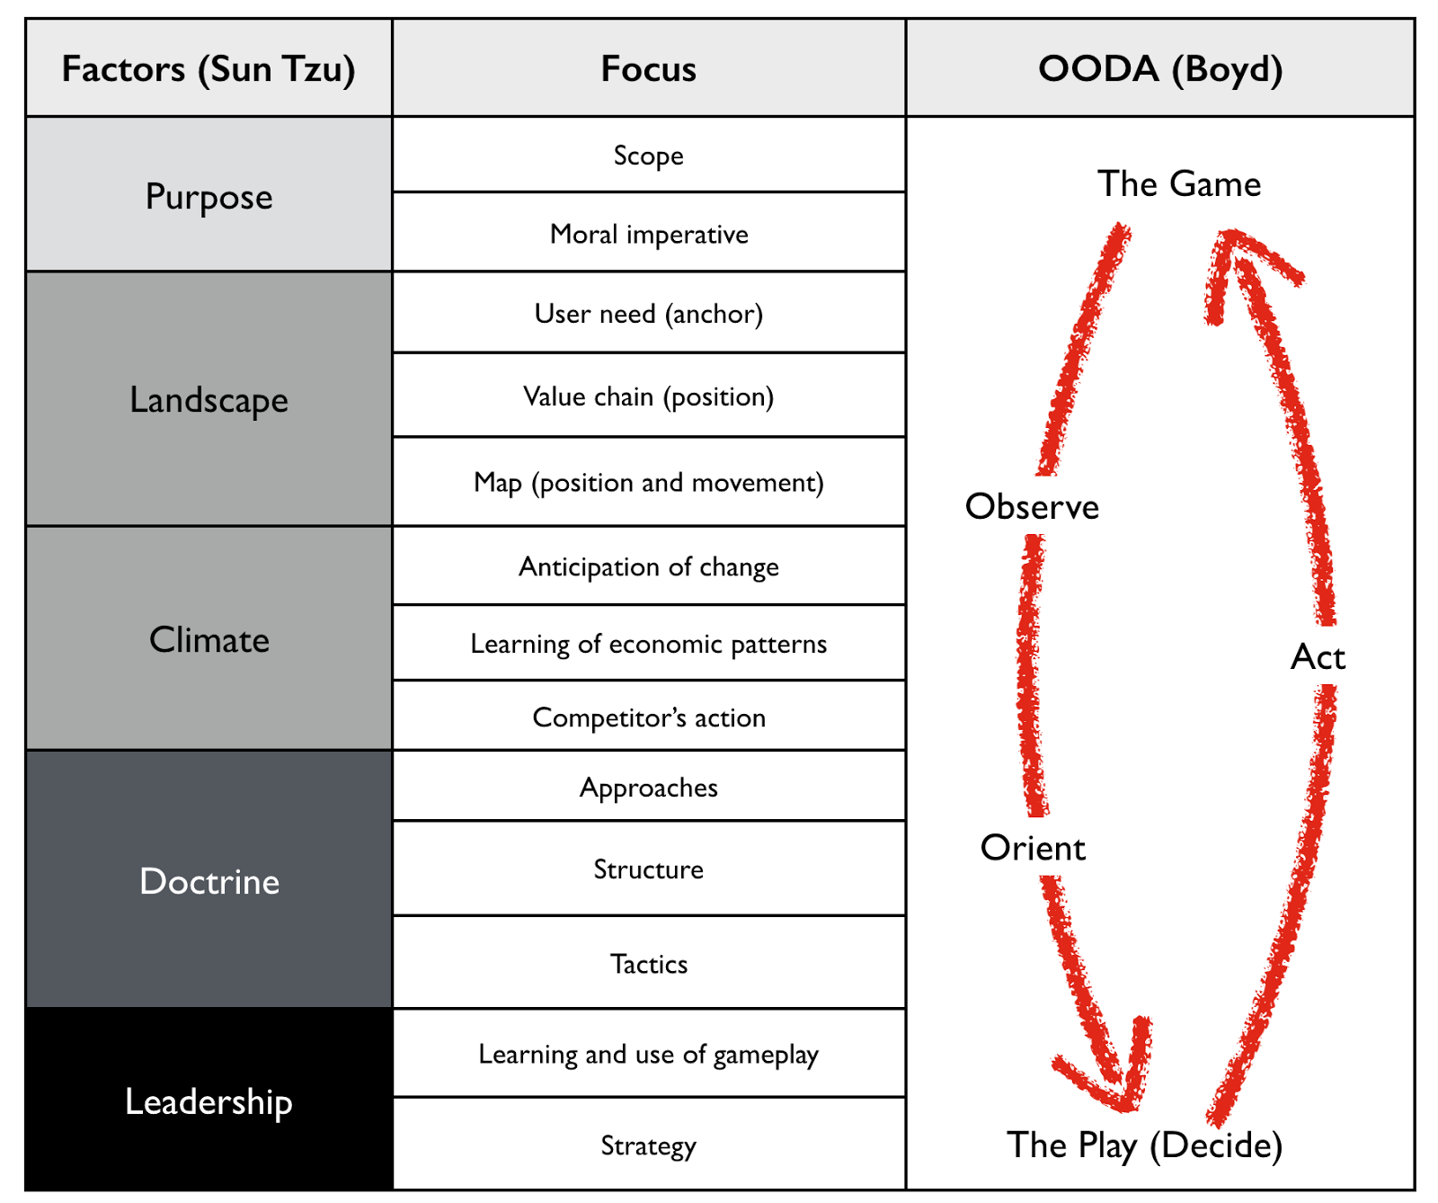
Wardley Mapping and the Strategy Cycle
@swardley
@madplatt

Slide 9
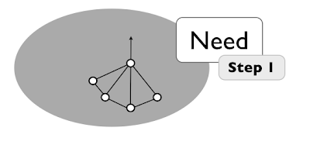
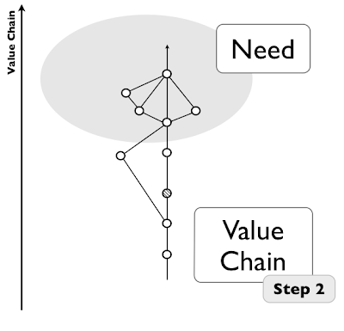
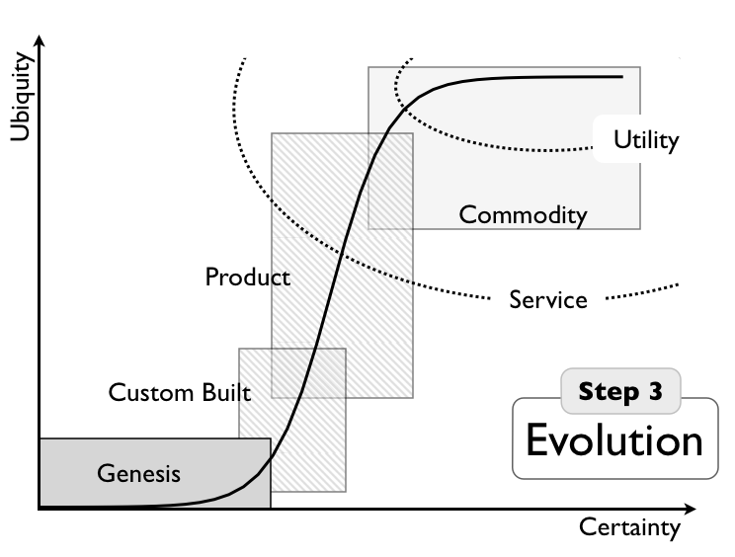
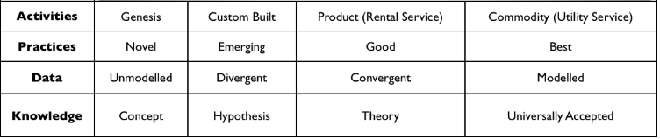
Building a map
@hiredthought – Ben Mosior
LearnWardleyMapping.com
@madplatt

Slide 10
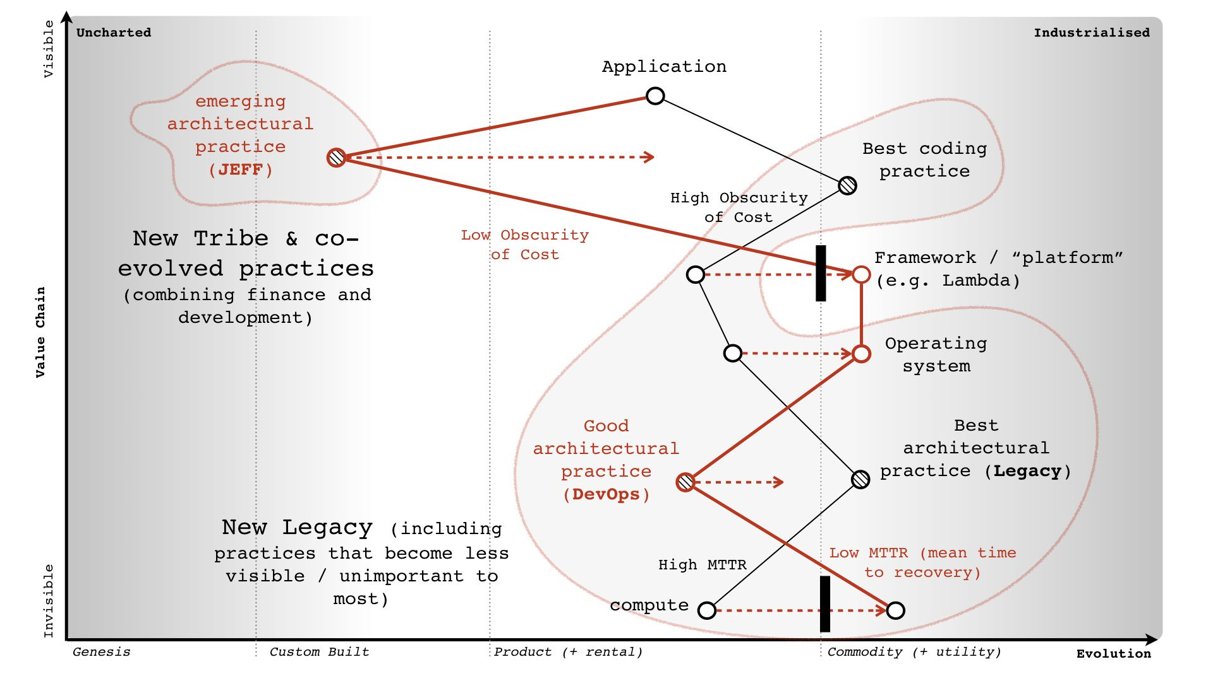
https://twitter.com/swardley/status/914792448429297664
@madplatt

Slide 11
Sense-making our environment
@madplatt

Slide 12
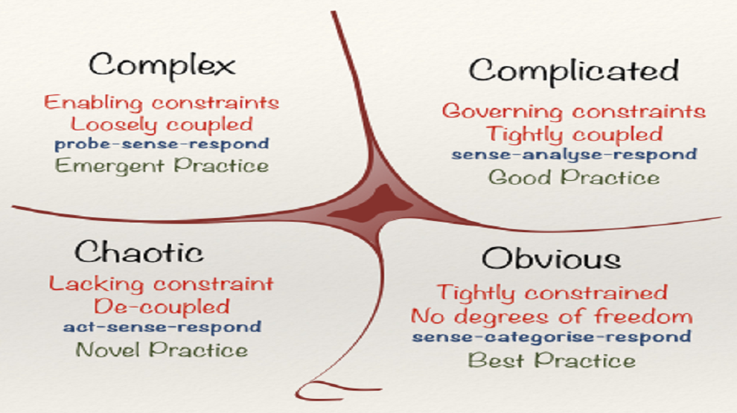
Cynefin Framework
@snowded
Cognitive-edge.com
@madplatt

Slide 13
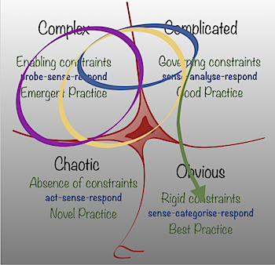
Cynefin Framework
@snowded
Cognitive-edge.com
https://cognitive-edge.com/blog/cynefin-dynamics/
@madplatt

Slide 14
Security Models and Frameworks
@madplatt

Slide 15
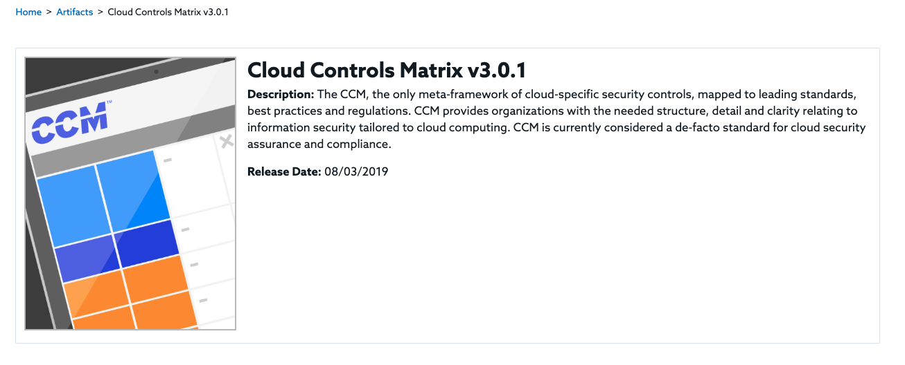
Compliance Maze
Which should you align to ? Be audited on ? Simplify with Off-the-shelf mappings
Focus on the mitigations, the rest is mostly noise. Yes, that includes GDPR!
https://cloudsecurityalliance.org/artifacts/cloud-controls-matrix-v3-0-1/
@madplatt
Notes:
44 standards in CSA alone

Slide 16
Structure
Centrally Managed (by CISO)
Audit Liaison
Metrics Tracking
Plan of Action & Milestones
Security Project Management
Assess Risk
Implement Policy and Controls
Promote awareness
Monitor and Evaluate
CISO Compass, CRC Press, Fitzgerald
@madplatt
Notes:
Assess Risk
Risk assessment and analysis Systems Security plan Penetration & Security testing Cyber Insurance 3rd party Risk Management
Implement Policy & Controls
Security Policy Security Architecture Security Control Assessment BCP and DR Control Framework Compliance
Promote Awareness
End User Security Awareness Internal Policy Publication Targeted awareness Phishing programs Reporting
Monitor and Evaluate
Security baseline configuration Vulnerability Assessment ncident Response Forensic Analysis Threat Intelligence

Slide 17
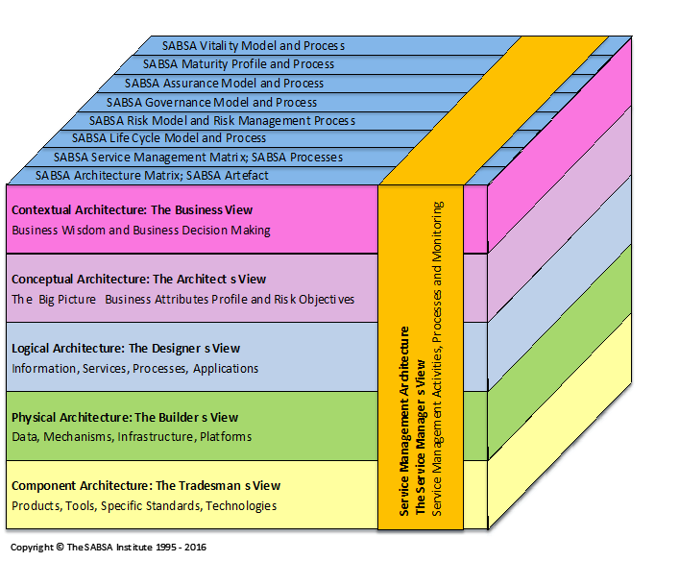
Enterprise Security Architecture
https://sabsa.org/the-chief-architects-blog-a-brief-history-of-sabsa-21-years-old-this-year/
@madplatt

Slide 18
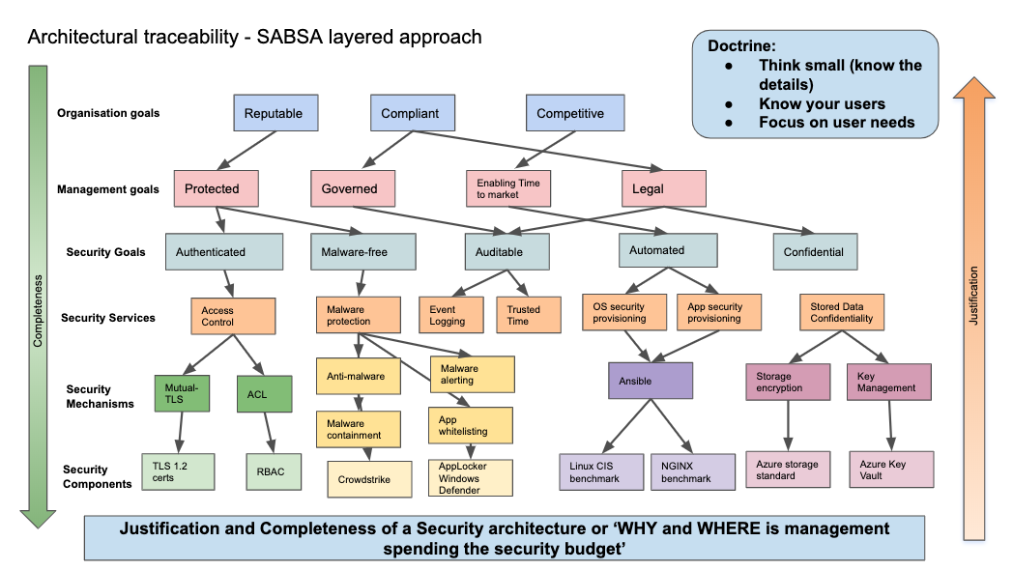
Enterprise Security Architecture
@madplatt

Slide 19
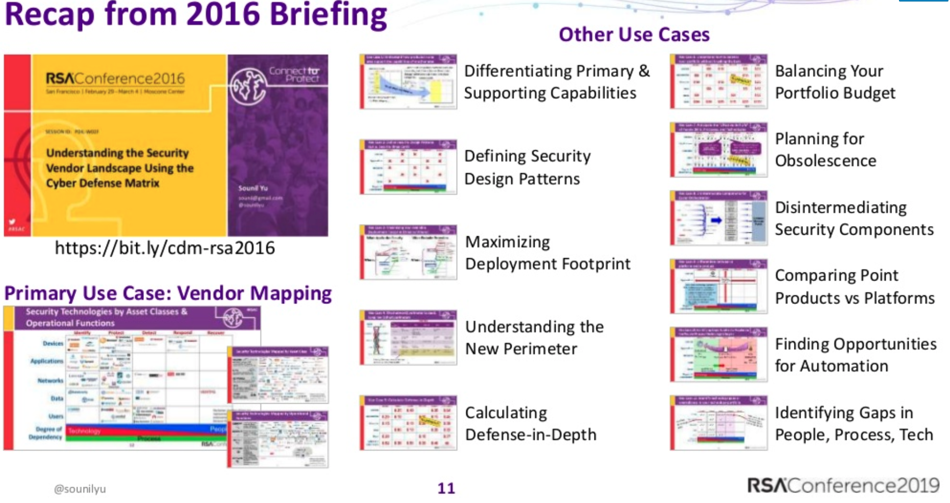
Cyber Defense Matrix
@madplatt

Slide 20
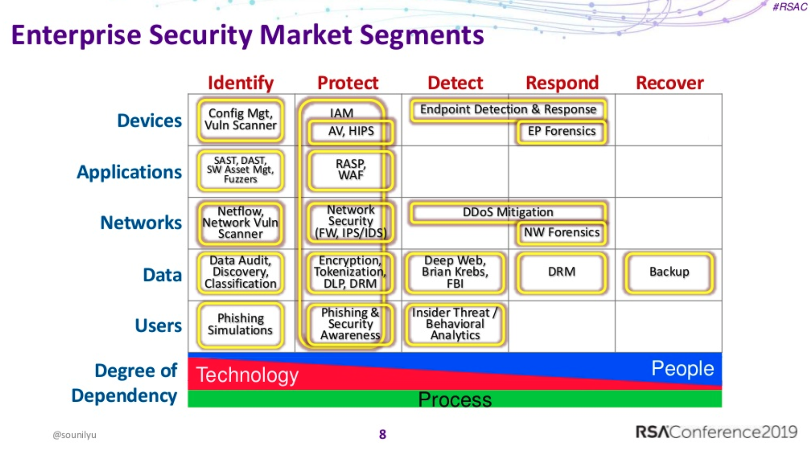
Cyber Defense Matrix
https://www.owasp.org/index.php/OWASP_Cyber_Defense_Matrix
@madplatt

Slide 21
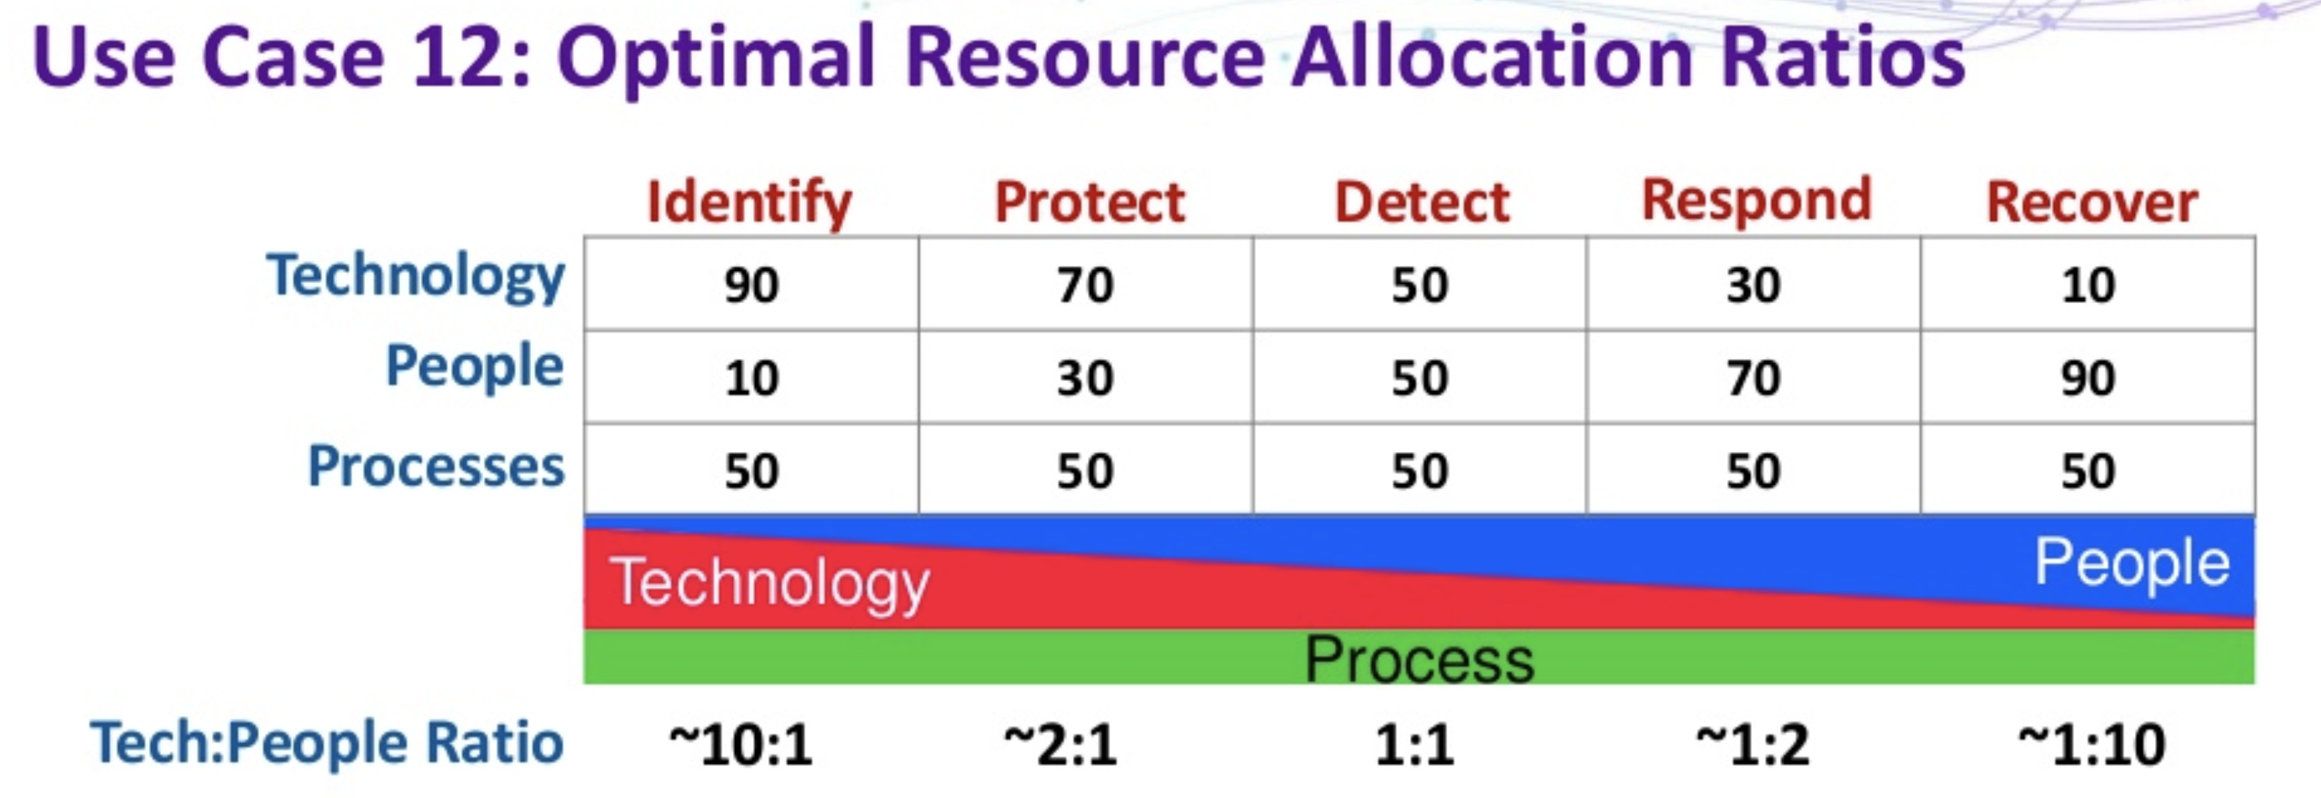
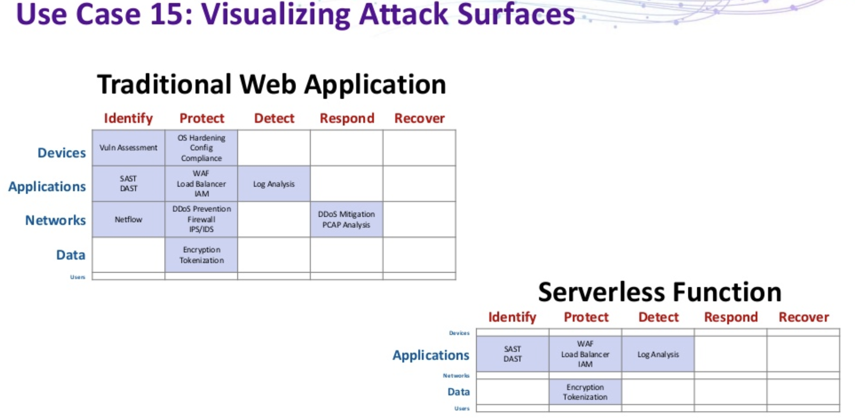
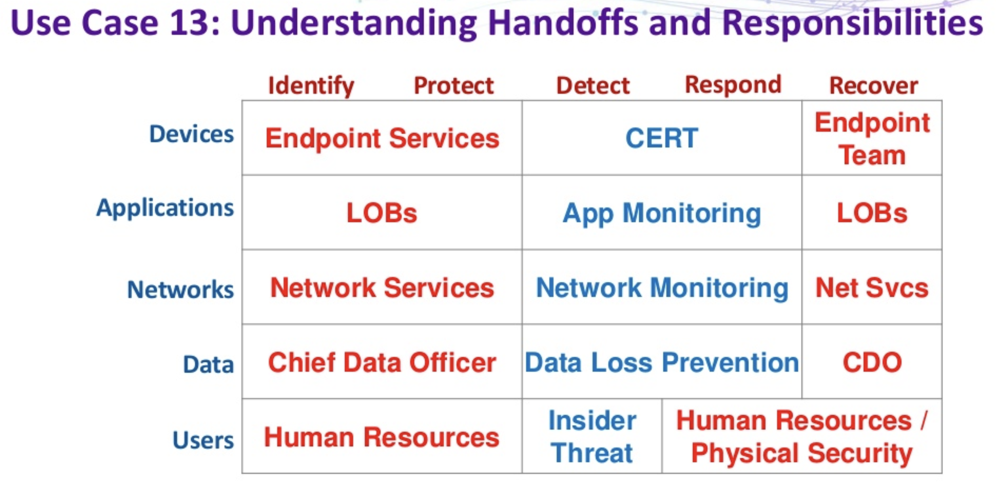
Cyber Defense Matrix
@madplatt

Slide 22
Mapping to the NIST Cyber Security Framework
Era
1980s
1990s
2000s
2010s
IDENTIFY
PROTECT
DETECT
RESPOND
Core Challenges
What did we buy and how does it support the biz?
Viruses, Server-side Attacks, Insecure Configs
Too many logs and alerts, Client-side attacks
Assume Breach, Raging Fires, Too Many Privileges
Solutions
Asset Mgt, Systems Mgt Tools
Anti-Virus, Firewalls, Secure Configs
IDS, SIEM
Incident Responders & IR Tools (EDR, SOAR)
STABILITY
(CIO)
IT / Security Tension
SECURITY
(CISO)
Security Team
Composition
& Focus
None
Hobby Shop / Vulnerability Mgt
Sec Ops Center / Threat Mgt
Dedicated Biz Unit / Risk Mgt
@sounilyu
https://www.slideshare.net/sounilyu/distributed-immutable-ephemeral-new-paradigms-for-the-next-era-of-security
Notes:
IDENTIFY, PROTECT, DETECT, RESPOND. Sound familiar? These are the first four functions of the NIST Cybersecurity Framework. The fifth and last function? RECOVER.

Slide 23
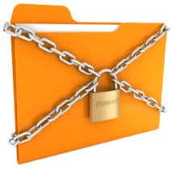


2020s: Age of Recovery (or Resiliency)
What kind of attacks should we see in the 2020s that would challenge to our ability to RECOVER or cause irreversible harm?
Confidentiality
Integrity
Availability
Wikileaks
Doxxing
Ransomware
#fakenews
PDoS, MBR Wiper, Bricking Firmware
@sounilyu
https://www.slideshare.net/sounilyu/distributed-immutable-ephemeral-new-paradigms-for-the-next-era-of-security
Notes:
So then the 2020s will be the age of recover, or as I would prefer to call it, it’s the age of resiliency.
But what might the RECOVER or RESILIENCY era look like? Or more specifically, what types of problems will we see in this era that will challenge our ability to recover?
If we map potential challenges against the traditional security paradigm of Confidentiality, Integrity, and Availability, then the types of attacks that we would see in the Age of Recovery are attacks that undermine our ability to recover from the loss of CIA.
I would propose that such challenges will manifest in the form of destructive or irreversible attacks that result in our inability to recover. Of course, we have already seen manifestations of this type of attack in the form of Wikileaks, Shamoon, and NotPetya. But these are all just the tip of the iceberg.
In the 2020s, we will see the full maturation of irreversible attacks that completely undermine our ability to recover.

Slide 24

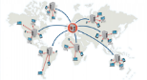
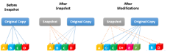






But wait! How are these “security” solutions?
Distributed
Immutable
Ephemeral
DDoS Resistant
The best solution against a distributed attack is a distributed service
Changes Easier to Detect and Reverse
Unauthorized changes stand out and can be reverted to known good
Drives Value of Assets Closer to Zero
Makes attacker persistence hard and reduces concern for assets at risk
Availability
Integrity
Confidentiality
@sounilyu
https://www.slideshare.net/sounilyu/distributed-immutable-ephemeral-new-paradigms-for-the-next-era-of-security
@swagitda_
https://swagitda.com/speaking/us-19-Shortridge-Forsgren-Controlled-Chaos-the-Inevitable-Marriage-of-DevOps-and-Security.pdf
Notes:
As I looked across all these recover-oriented solutions, I found three new paradigms that undergirded these solutions.
Now you may wonder, how do these paradigms help with security?
But more than just helping with security, it turns out, these new patterns can eliminate the need for security at all.
If I have something that is highly distributed, why do I need to worry about a single system’s availability?
If I have something that is immutable, why do I need to worry about its integrity.
If I have something that is highly ephemeral, why do I need to worry about its confidentiality?
It turns out, if we leverage these three paradigms of DIE, we might not need to worry about CIA.
If we can have our assets DIE, then do we need to CIA them?

Slide 25
The role of Open Source and Cloud Native

Slide 26
Reducing excuses barriers to entry and commercial co-dependence in security visibility

Slide 27


Securing your apps
Requirements
Implementation
V3: Session Management Verification
Session Management Cheat Sheet
Notes:
Will provide info on Session ID fingerprinting, lenght, ID entropy, content and others

Slide 28









Securing your apps & infrastructure
Static analysis
Dependencies
Dynamic Analysis
Compliance checking and Hardening
Dev-sec.io
Npm audit

Slide 29
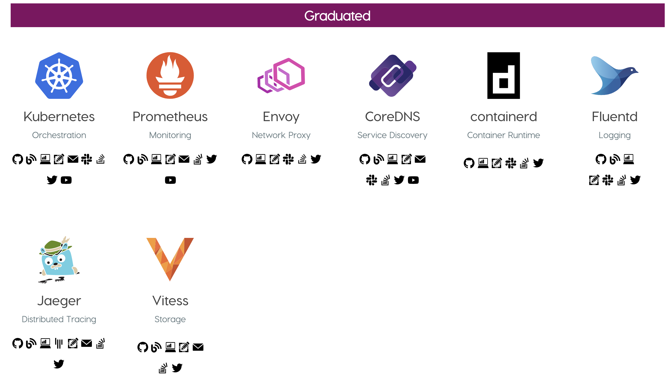
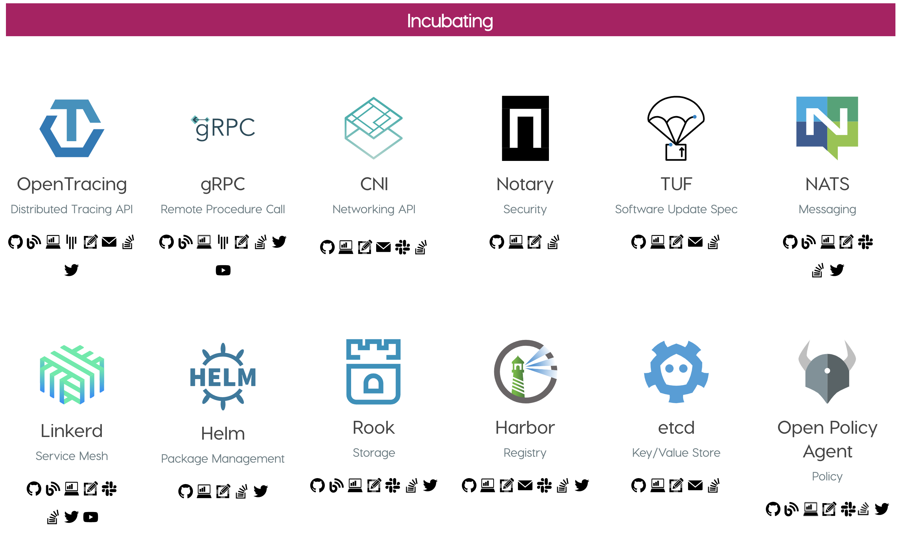
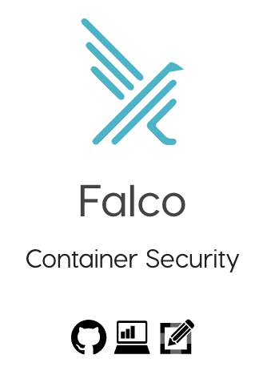
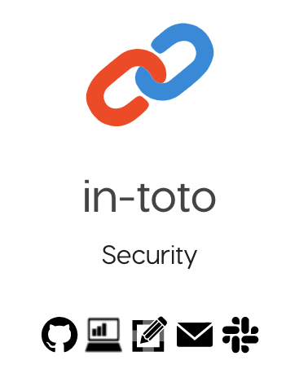

Cloud Native Foundation

Slide 30
Conclusion
Before we can talk strategy, we need to agree on what we mean by that
Treat problems according to its nature
Security without an Enterprise architecture is hand-waving/bias of the highest paid
Models as communication tools
Pets are treated with C.I.A. Cattle with D.I.E
Operational paradigms have shifted. Speed begets assurance
Cloud native is happening. Consider it first, before investing elsewhere

Slide 31

Questions ?
Mario.Platt@privacybeacon.io
Twitter: @madplatt
LinkedIn: /in/marioplatt/
Medium: https://medium.com/@marioplatt

